Slide 1
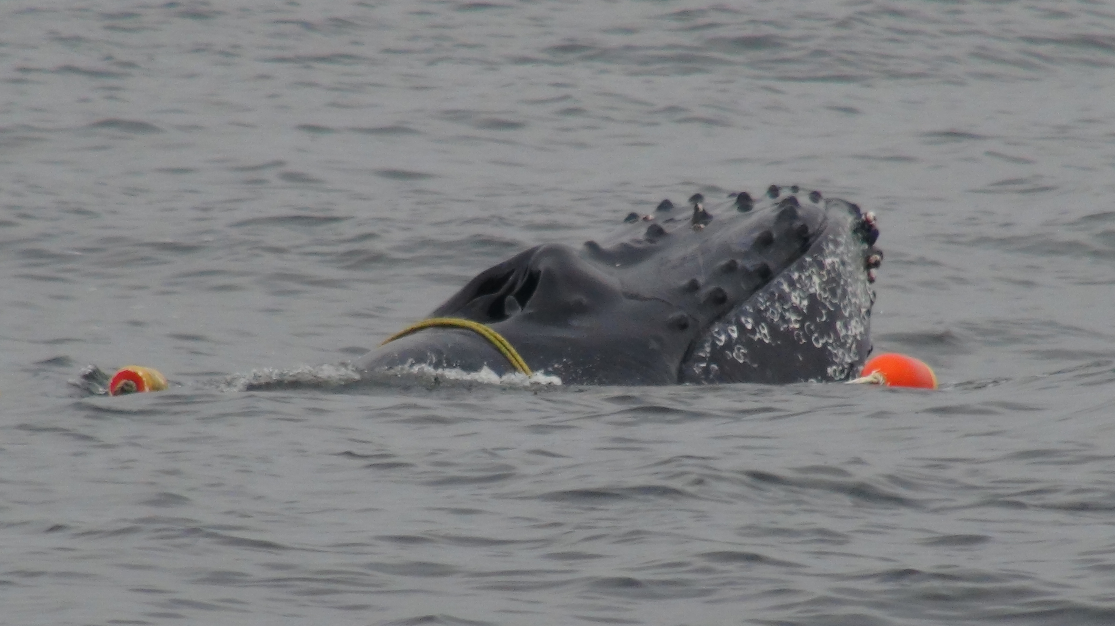
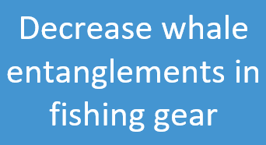

Slide 2
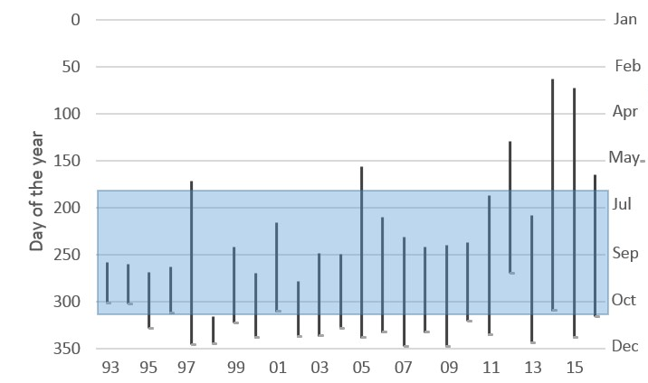
Humpback whales are arriving earlier
Earlier arrival of whales exposes them to fishing gear for a longer period of time
New Closure 2020
Crab fishing CLOSED
Notes:
We can start the whale entanglement story by looking at when whales arrive in the central California Current.
This figure shows the year on the x-axis, the day of year on the y-axis, and the lines for each year show the time when HUWH are present in central California.
The tops of the lines indicate when they were first observed in the region, and you can see that there is a trend towards earlier arrival dates through time.
This wasn’t an issue with entanglements until recently, as you can see that in the earlier years, HUWH were arriving when the crab fishery was closed. But they are now arriving when the fishery is open, and this is causing some issues.
**New fishery closure dates have been enacted. Right now, the fishery has been delayed to Dec 15th due to the increased number of whales observed in the region.
It is our hope that these measures will reduce the number of entanglements in the early part of the year (Apr-Jun).

Slide 3
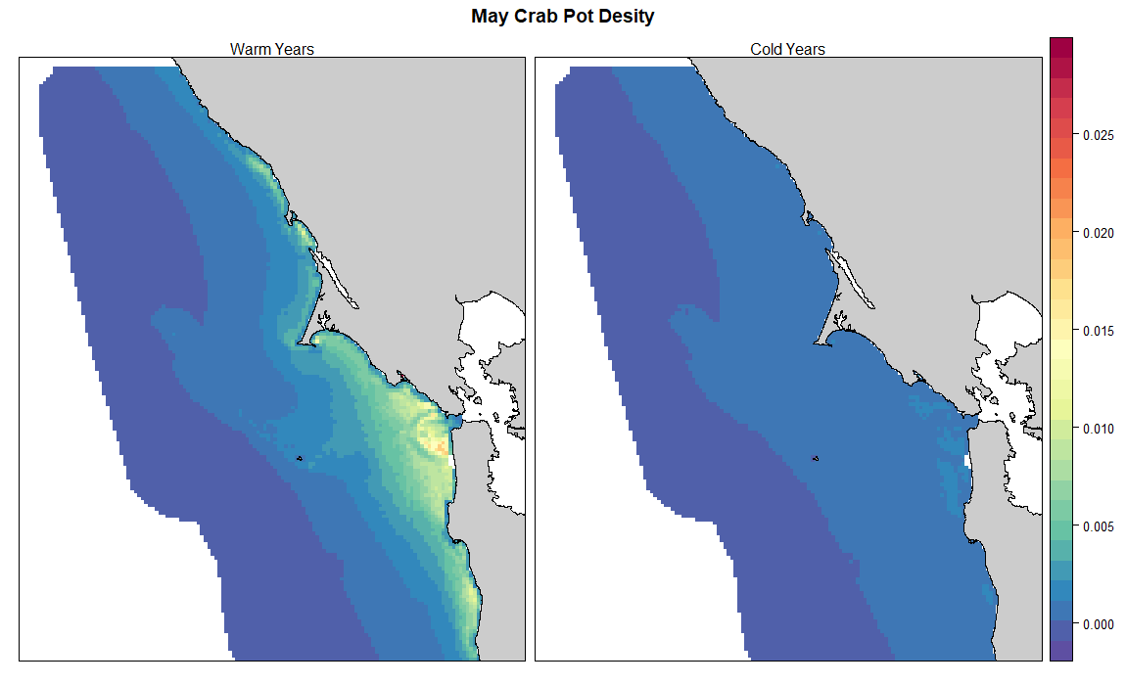
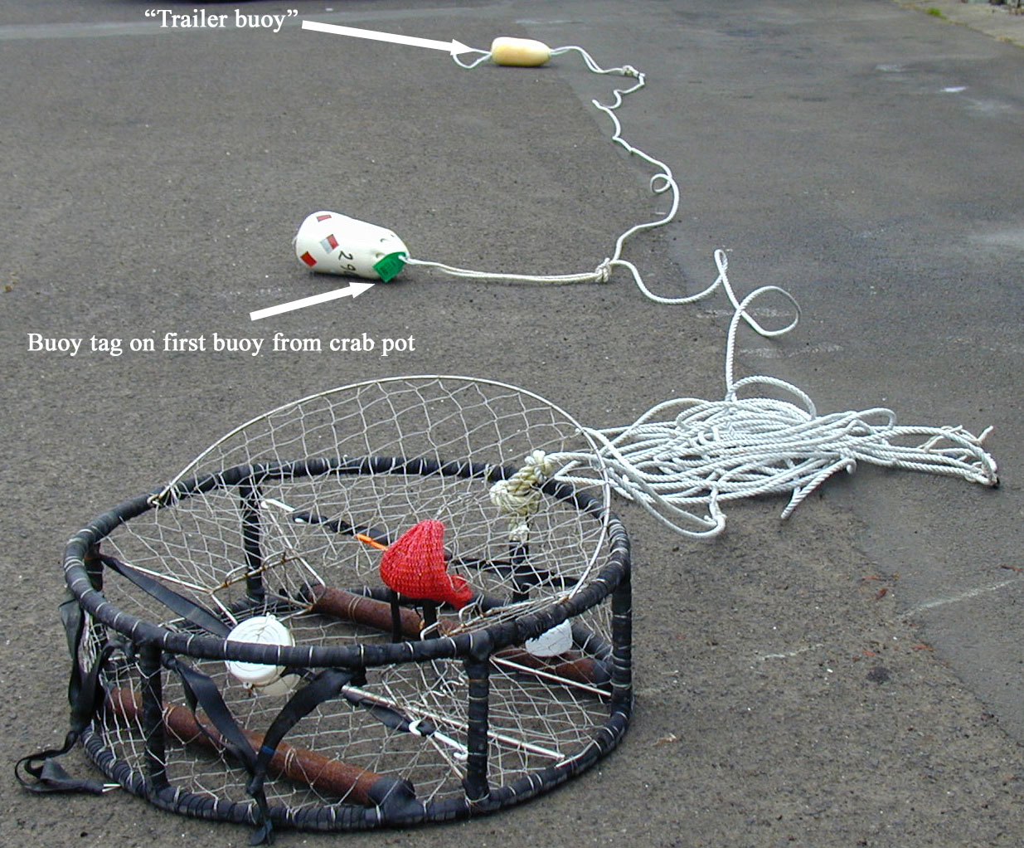
Crab pot gear in warm and cold years
Crab fishers work into May/June during warm years, and retreat early in cold years
Warm/poor productivity years
Cold/good productivity years
Notes:
During the ACCESS cruises, we record where we see crab pot gear.
In general, our observations show that crab pots are left out longer into the spring during the warm years, shown in the map on the left.
Most of the crab fishing gear is close to shore, just outside San Francisco Bay and south of Pillar Point.
In cold years (shown on the right), the crab pots are removed sooner (in the winter) as fishermen move on to work on other fisheries (e.g., salmon).

Slide 4
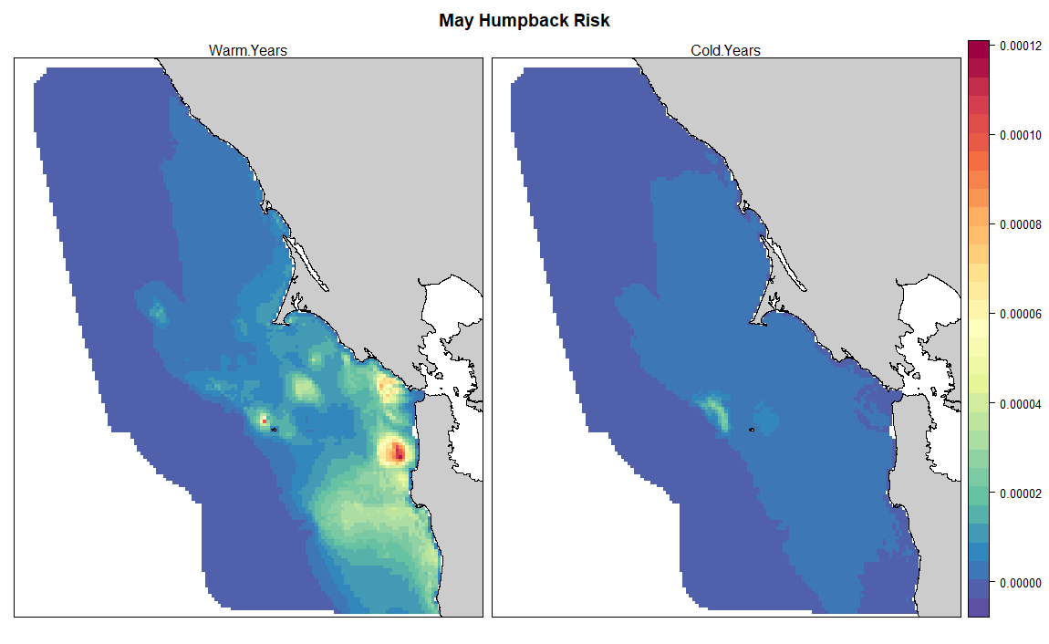
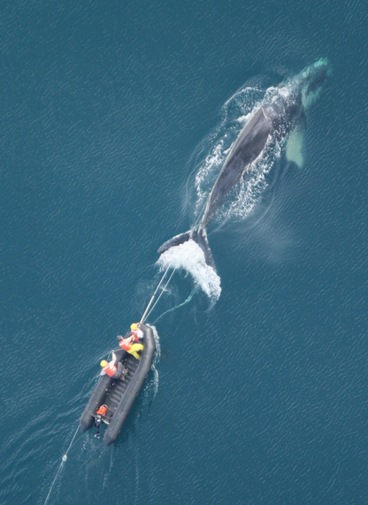
Entanglement risk for humpback whales
Whales at greater risk during warm years, than during cold years
Warm/poor productivity years
Cold/good productivity years
Notes:
When we combine whale distribution maps with crab pot distribution maps, we can see where the areas of high co-occurrence are and the areas where whales are at greater risk of entanglement.
In the warm water years (shown in the middle figure), the areas of high co-occurrence are just outside of San Francisco Bay and near Pillar Point harbor.
The areas of high co-occurrence are greatly reduced in the cold years, shown in the figure on the right.
So looking at when and where whales and fishing gear can co-occur can help in reducing entanglements.

